Slide 1
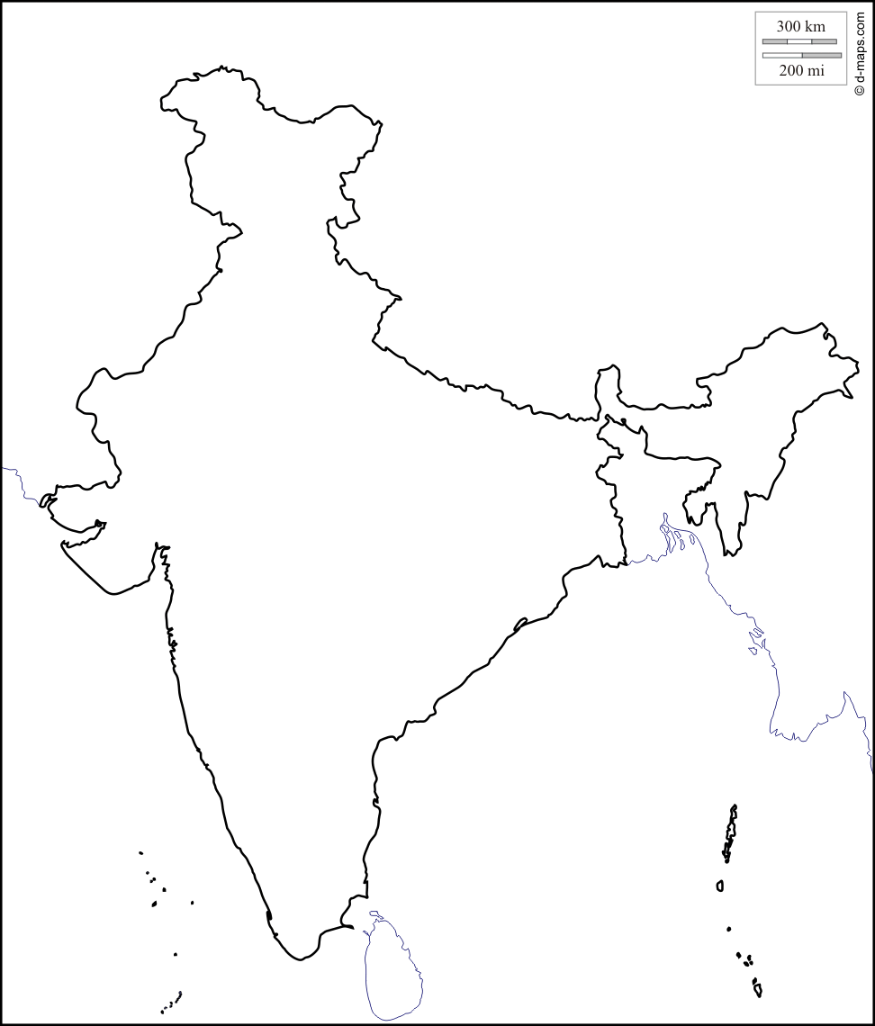
Successors State
Bengal
Awadh
Hyderabad

Slide 2
Nature of Successor State
Successors state once under the hegemony of the Moghul rulers as provincial heads, Governors
Their headship & Governorship became hereditary in nature after the start of the decline of Moghul dynasty
These Successors state accepted the Moghul sovereignty and accept the Moghul kings as their kings.
They pay tributes and a portion of state revenue to Moghul treasury

Slide 3
Warriors State
Sikh State
Maratha State
Travancore
Mysore State

Slide 4
Nature of Warrior State
These state were the upshot of social reformers like Ram Das, Guru Arjun Dev, etc
These state were established to safe their religion from aggression of Islam
And also to halt growth the lslam growth in their region.

Slide 5
Little Kingdoms
Palayams (42 in Tamil Region)
Total around 450

Slide 6
Nature of Little Kingdoms
The term first coined by Bernard S. Cohn in his book Banaras Region- later used following historians like, Nicolas B. Dricks and S. Manikandan
These territories were although small in size it had the nature of kingdoms (way of adopting King’s life style)
These state accepted suzerainty of they superiors like Nizam and Nawab
Later these small kingdoms transferred to East India Comapny

